Slide 1
Weekly report: Foundations
Week number: 10
Date: 02/12/2025
Supervisor: Prof. Dr.-Ing. Torsten Faber
Group members : Jehad Albaali- Amgad Gerges - Reda Deif
presented by : Jehad Albaali
02/12/2025

Slide 2
Project Data & Geometrics
L Dimensions
Hub Height: 100 m
Tower Base Diameter: 4.8 m
Pedestal Diameter: 7.0 m
Raft Diameter: 25.0 m
Middle Slab Thickness: 2.0 m
Materials {EC2)
Concrete Class: C35/45
Cylinder Strength (fck): 35 MPa
Reinforcing Steel: 8500 (fyk = 500 MPa)
Anchor Bolts: Grade 10.9 (fub = 1000 MPa)
Group members: Jehad Albaali- Amgad Gerges - Reda Deif
Foundations team/ Optimus Syria

Slide 3
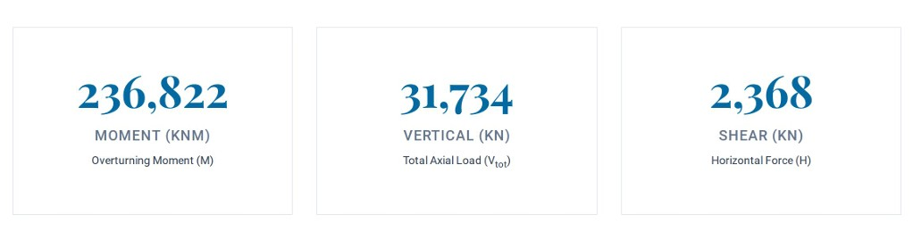
Design Action (ULS)
The foundation is subjected to extreme overturning moments due to the 1OOm hub height.
02/12/2025
Jehad Albaali
Foundations team/ Optimus Syria

Slide 4
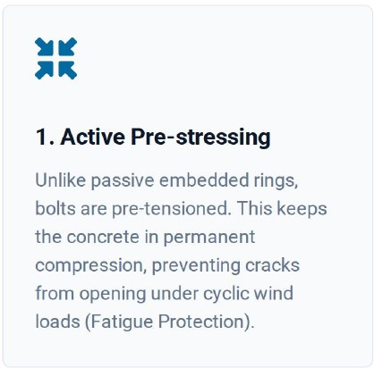
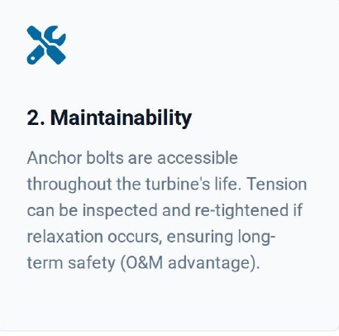
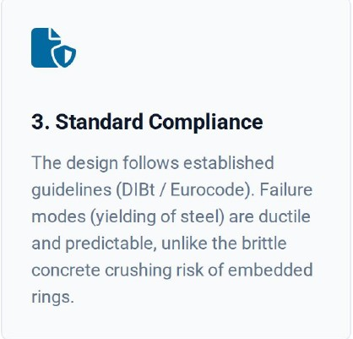
Why Anchor Cage Connection ?
Considering the tower diameter (4.8m) and dynamic nature of loads, the Anchor Cage system was selected over the Embedded Ring for three critical reasons:
02/12/2025
Jehad Albaali
Foundations team/ Optimus Syria

Slide 5
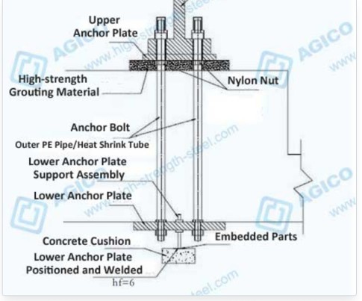
Anchor Cage Design Concept
A Single-Row anchor cage configuration was selected to simplify installation and concrete flow compared to double-row alternatives.
Bolt Size: M48 (Grade 10.9)
Number of Bolts: 96 Units
Circle Diameter: 4.6 m
Spacing: -150 mm c/c
Source: www.high-strength-steel.com
02/12/2025
Jehad Albaali
Foundations team/ Optimus Syria

Slide 6
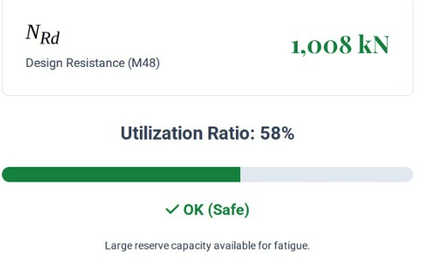
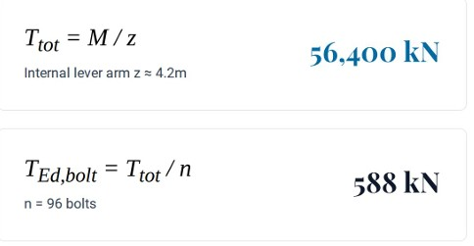
ULS Tension Capacity Verification
1. Load per Bolt
2. Bolt Resistance (Grade 10.9)
02/12/2025
Jehad Albaali
Foundations team/ Optimus Syria

Slide 7
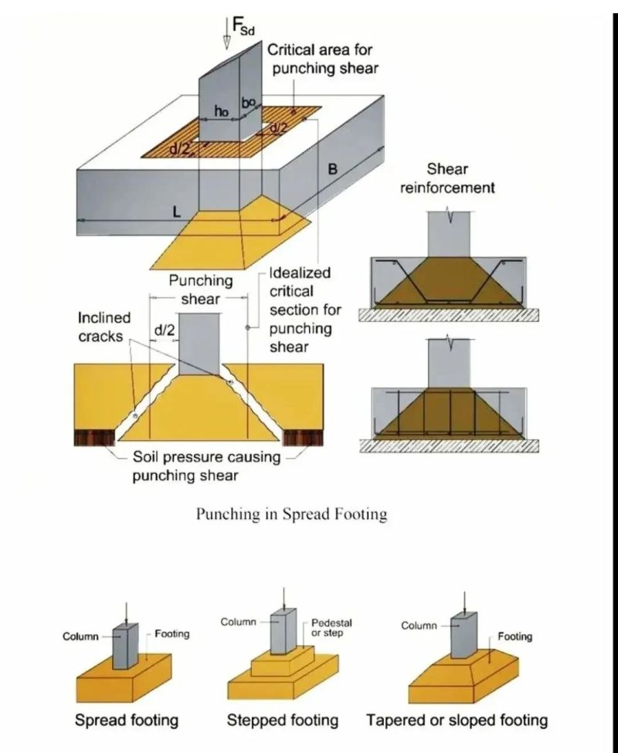
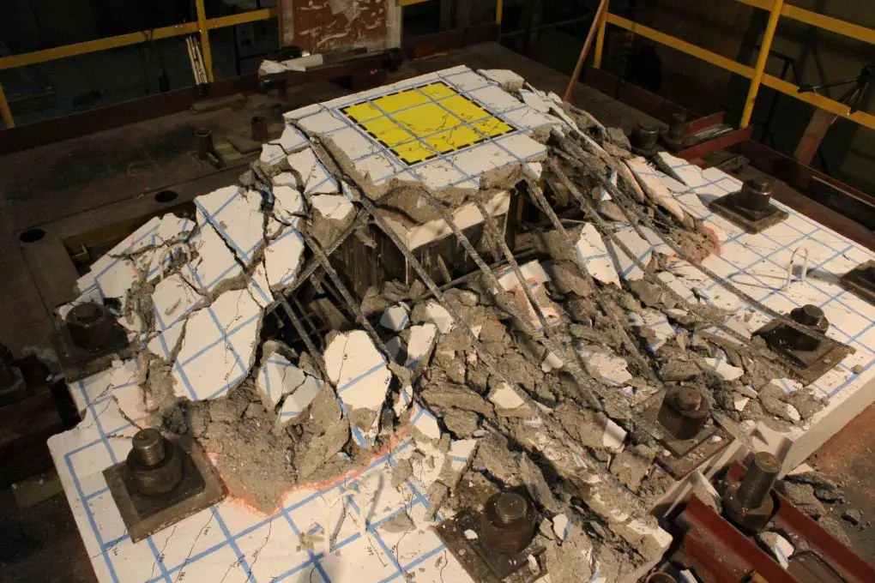
Critical Failure Check
Punching Shear at Pedestal
The calculation reveals that the concrete alone cannot resist the shear forces generated by the pedestal punching through the raft.
Applied Stress (vEd):
0.53 MPa
Concrete Capacity (vRd c):
I
0.41 MPa
FAILURE: VEd > VRdC
Conclusion: Shear reinforcement (studs or stirrups) is mandatory.
Source :https://structville.com/strengthening-flat-slabs-against-punching-shear
02/12/2025
Jehad Albaali
Foundations team/ Optimus Syria

Slide 8
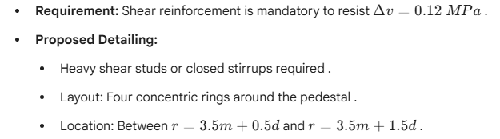
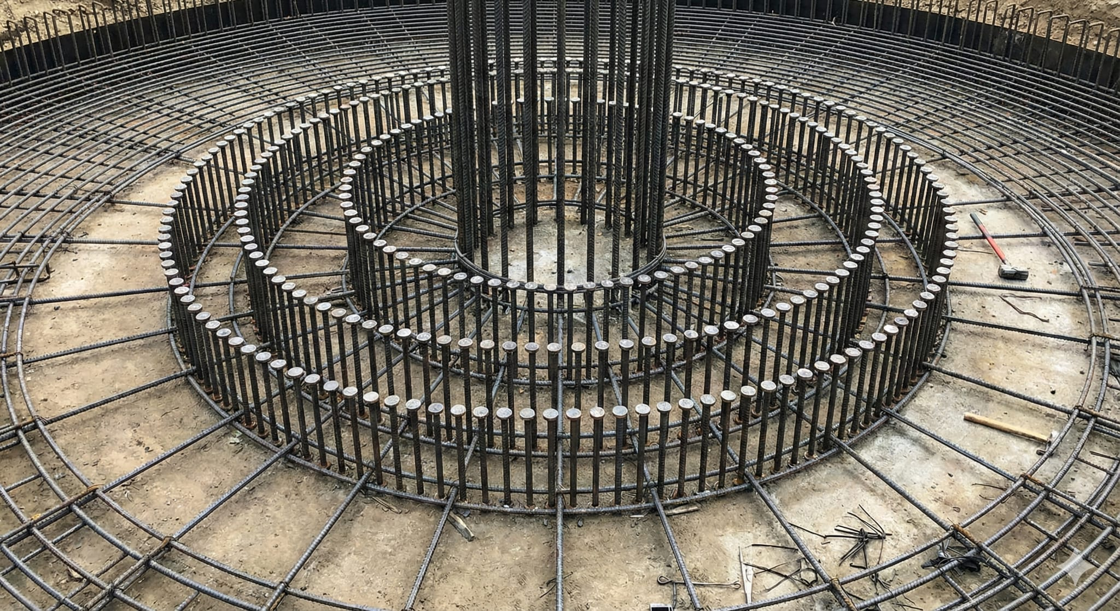
Shear Reinforcement Design
Sizeing : Ø16 or Ø20 studs with spacing s≤150mm
Source: Nanobanana
02/12/2025
Jehad Albaali
Foundations team/ Optimus Syria

Slide 9
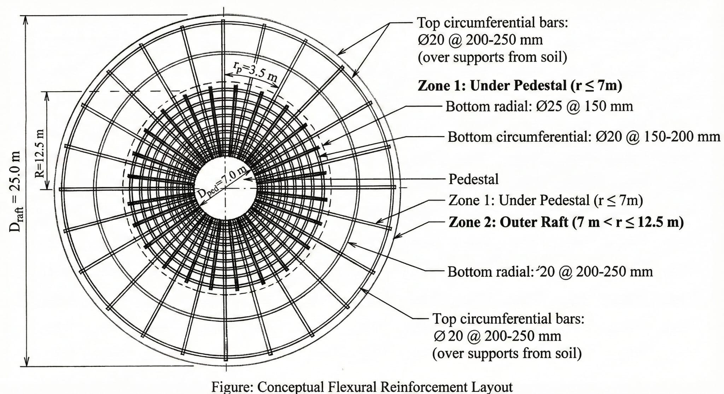
Flexural Reinforcment layout
Zone 1 : Under Pedestal ( r ≤ 7m )
Bottom Radial : Ø25 @ 150mm
Bottom Circumferential :Ø 20 @ 150-200 mm
Zone 2 : outer Raft ( r > 7m )
Bottom Radial : Ø20 @ 200-250 mm
Top Circumferential :Ø 20 ( to resist negative moments soil support )
02/12/2025
Jehad Albaali
Foundations team/ Optimus Syria

Slide 10
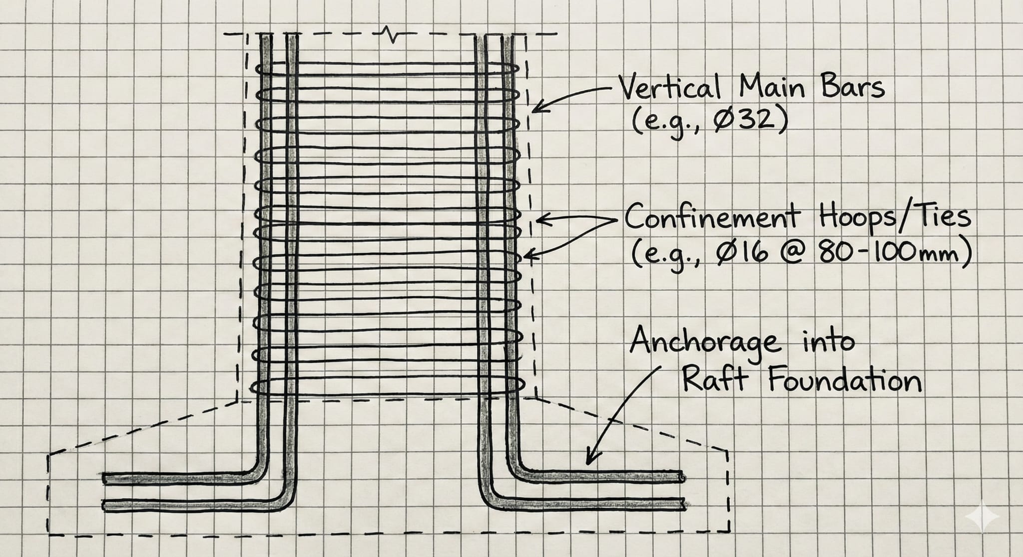
Pedestal Reinforcment
Objective : Confine the concrete core against high bursting forces from the anchor cage .
Reinforcement Details :
Vertical Main Bars : Ø32 @ 150mm ( Both Faces )
Confinement (Hoops / Ties ) : Ø16 or Ø20 Spacing ( 80-100 mm)
Anchorage : Must Extend Form the raft up to 1,0-1,2 above bolt level
02/12/2025
Jehad Albaali
Foundations team/ Optimus Syria

Slide 11
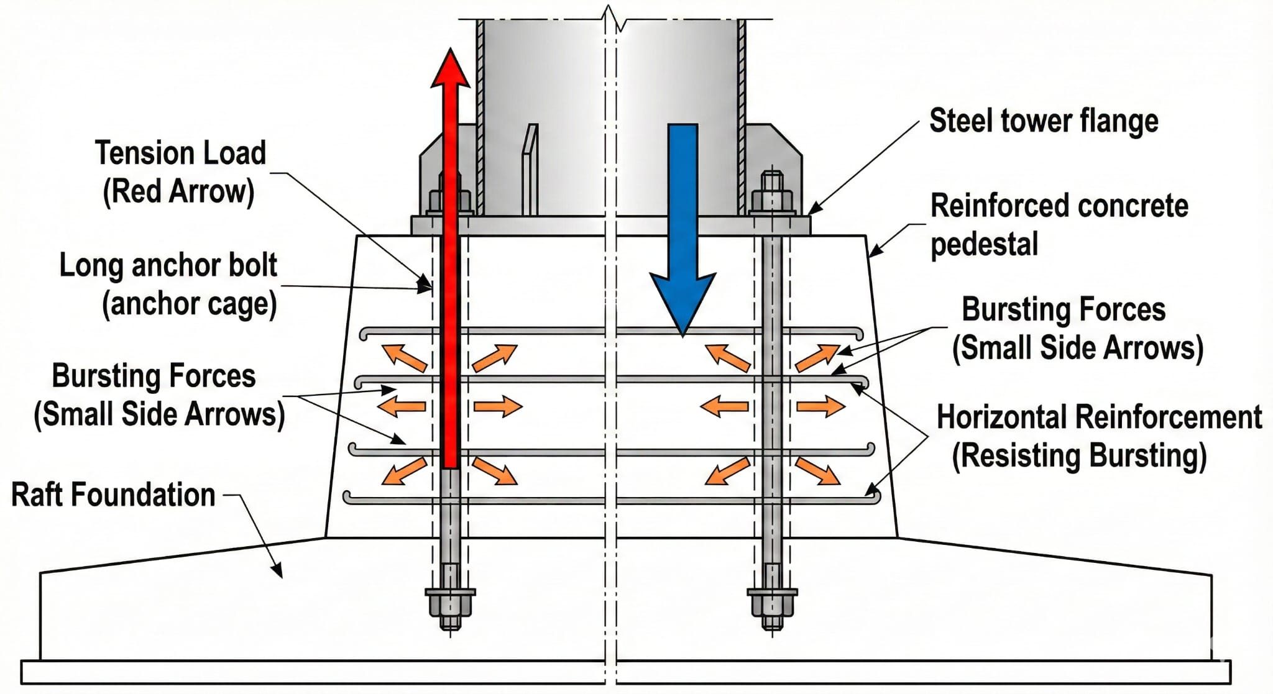
Load Transfer Mechanism
1-Tension ForceAction:. Wind loads Uplift
Resistance: 96 x M48 Anchor bolts transfer into concrete
Design Load: 588 KN per Bolt
2-Compression Force Action: moment + dead load
Resistance: The concrete core (C35/45)
3-Bursting Forces Action: High concentrated. Anchorage Forces
Resistance: Resisted by the dense confinement hoops.
02/12/2025
Jehad Albaali
Foundations team/ Optimus Syria

Slide 12
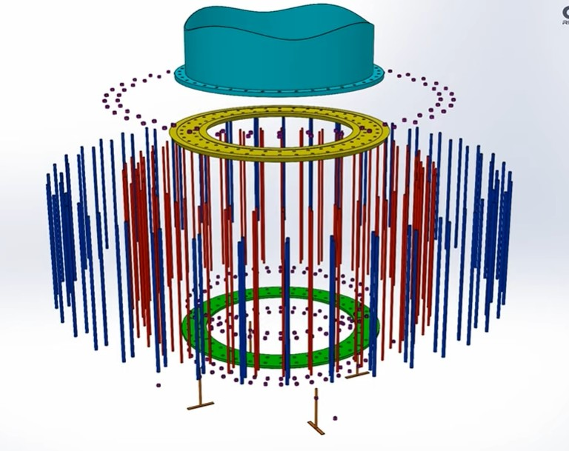
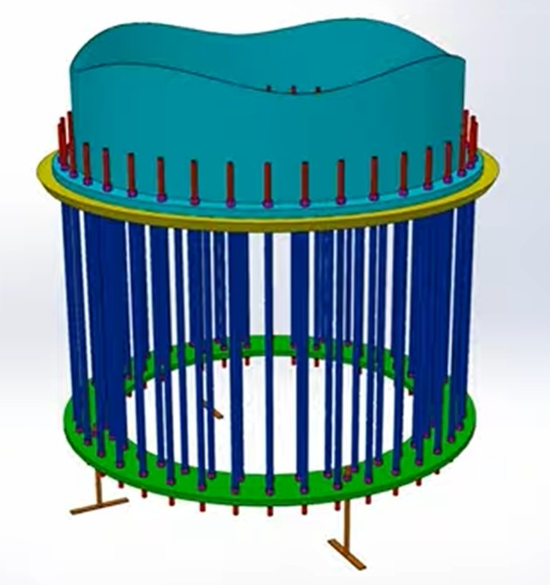
Structural Detailing Overview
https://www.youtube.com/watch?v=znEKJ4Jxhmo
Jehad Albaali
Foundations team/ Optimus Syria

Slide 13
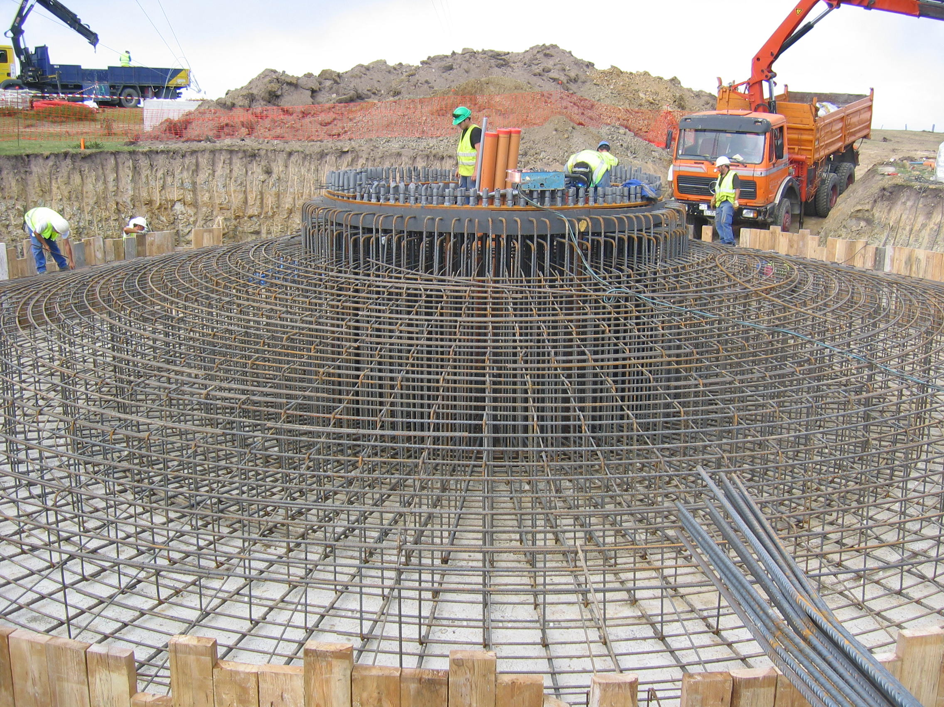
Summary
Conclusions:
The proposed 96 x M48 anchor cage is adequate for the overturning moment .
Punching shear reinforcement is mandatory at the pedestal interface .
A 2.0m slab thickness provides favorable effective depth for shear and bending .
https://www.youtube.com/watch?v=fpmd_br6loI
02/12/2025
Jehad Albaali
Foundations team/ Optimus Syria

Slide 14
References
EN 1992-1-1: Eurocode 2 — Design of Concrete Structures European Committee for Standardization (CEN).
DNV-ST-0126: Support Structures for Wind TurbinesDet Norske Veritas (DNV), Structural Design Standard, 2016.
IEC 61400-6: Wind Turbines – Part 6: Tower and Foundation Design RequirementsInternational Electrotechnical Commission (IEC).
02/12/2025
Jehad Albaali

